Slide 1
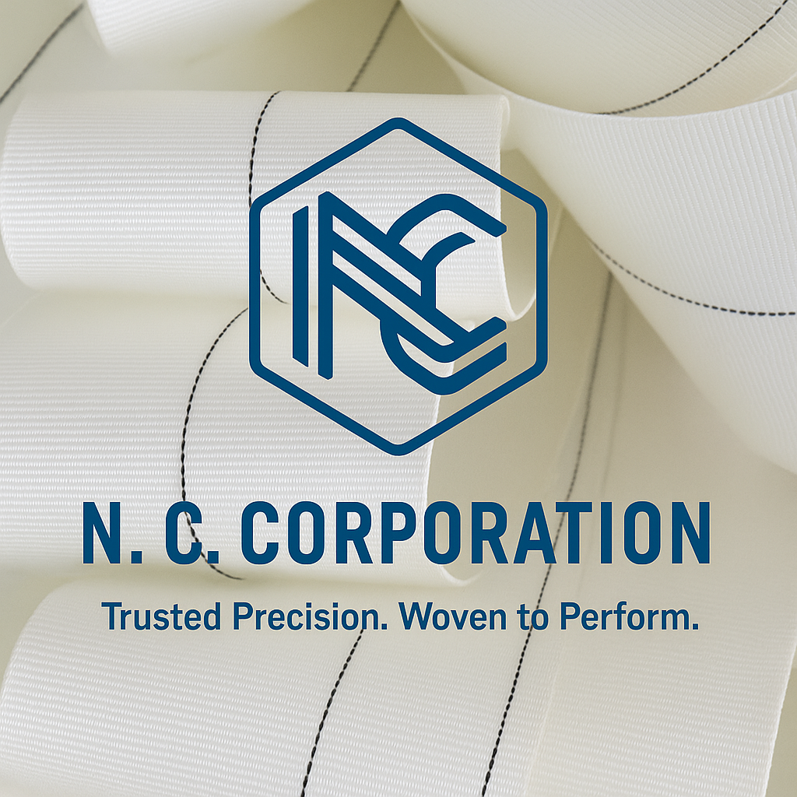

ISO Certified
Quality Assured

Slide 2
ABOUT US
Precision I Performance I Trusted
67 Years of Innovation and Growing with Global Footprint
Founded in 1957 by Late Shri Chandrakant R. Mehta, with a vision for Precision Manufacturing. N.C. Corporation has grown into a trusted name in high-performance webbing solutions, built on a foundation of precision, integrity, and innovation. We specialize in custom manufacturing of narrow woven fabrics technical textiles, Industrial tapes & webbing. for Global industrial applications with Superior quality and precision.
Industry Leadership with Excellence
Mr. Nimesh C. Mehta - A pioneer in technical textiles with over 45 years of hands-on experience and deep expertise in Nylon 66 and Polyester applications. Under his leadership since 1981, the company has become an industry leader in technical textiles and industrial webbing.
65,000 Meters/Day 8,000Sq.M Facility 67 Years Legacy

Slide 3
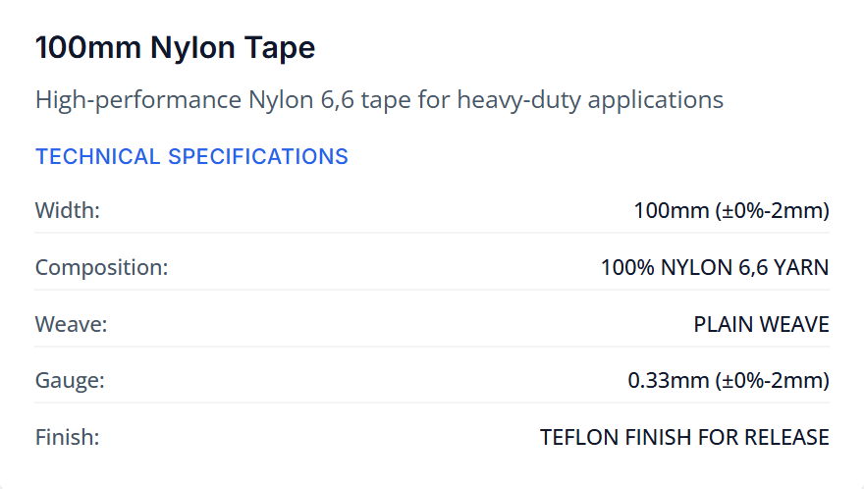
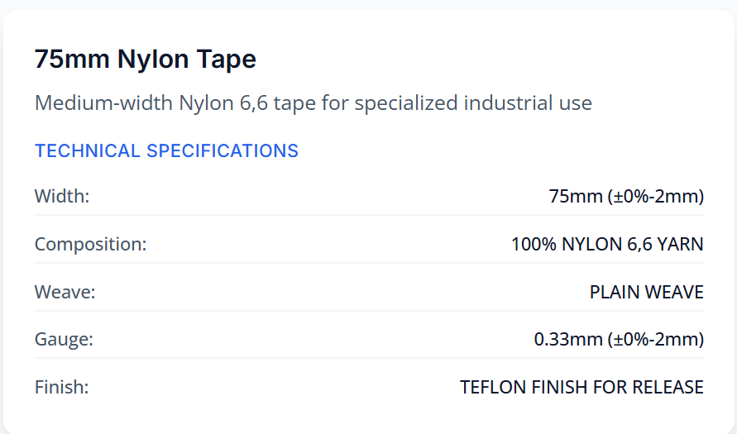
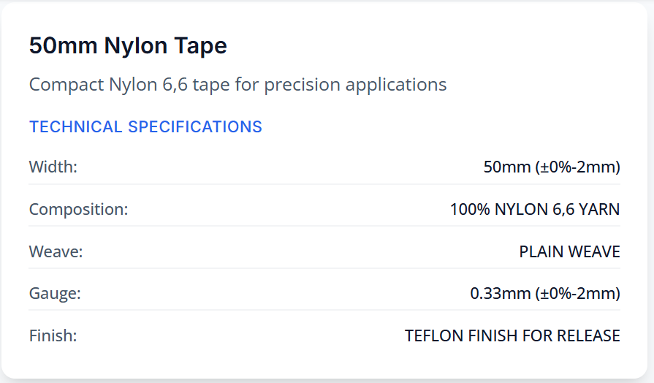
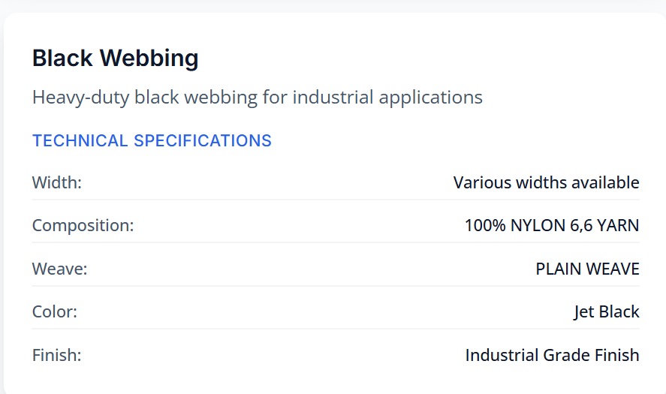
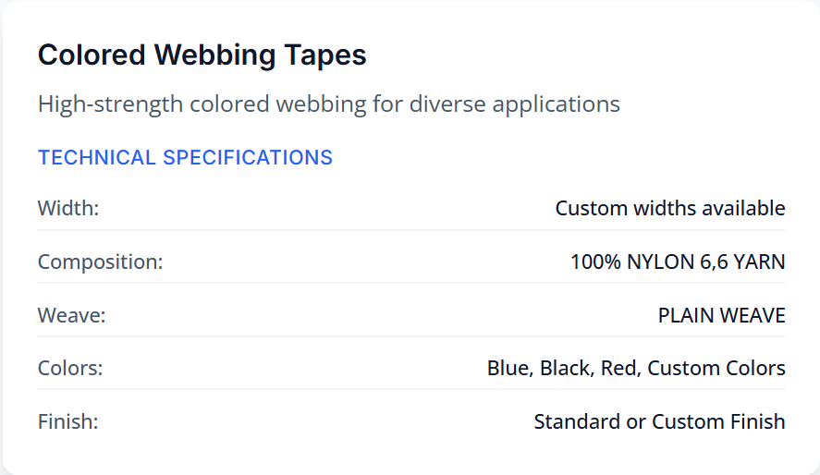
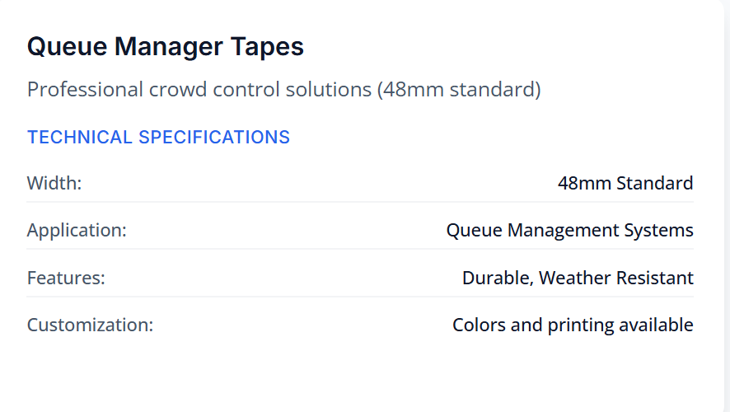
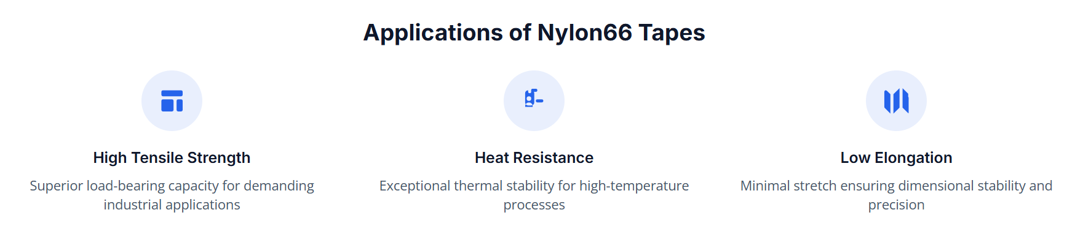
Our Specializations
High-performance narrow woven fabrics engineered for precision applications across multiple industries.

Slide 4
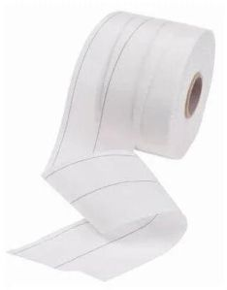
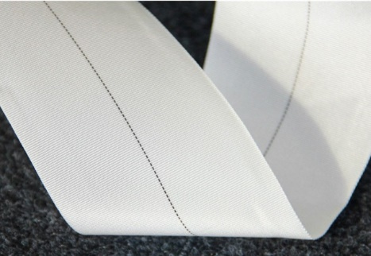
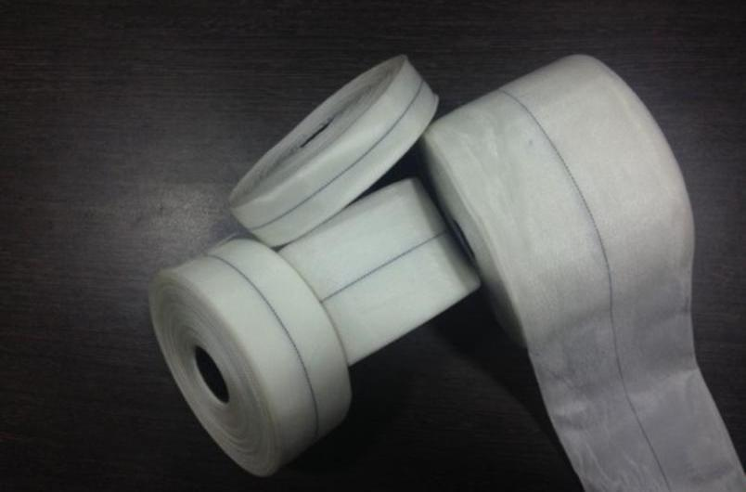
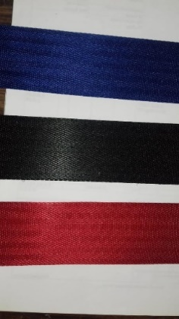
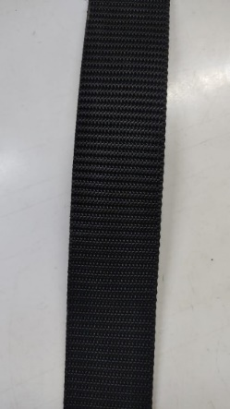
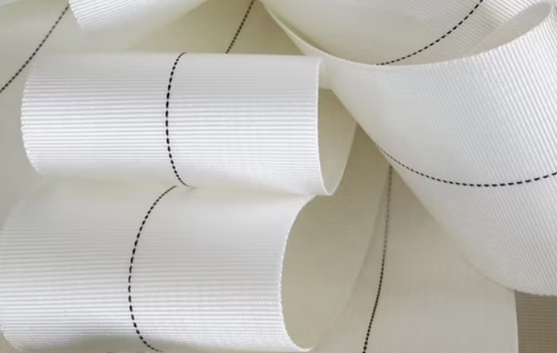
World-Class Manufacturing
Nylon 66 Tape Rollturing
100mm Nylon 66 tape roll precision manufacturing
Precision Markers
white tape with precision black markers
White Tape Rolls
white tape rolls ready for distribution
Colored Webbing
colored webbing tapes in blue, black and red colors
Black Webbing
black webbing showing detailed weave structure
Measured Precision
white tape with measurement markers
Innovation - Excellence – Commitment- Accountable

Slide 5
Commitment to Quality
Each meter undergoes rigorous in-house quality inspection to validate dimensional accuracy, mechanical integrity, and conformity to customer specifications.
Dimensional Accuracy
Precision measurements ensuring exact specifications for every product batch.
Mechanical Integrity
Comprehensive testing of tensile strength, elongation, and durability parameters.
Specification Conformity
Strict adherence to customer requirements and international quality standards.
100%Products Inspected ISO Certified Quality
67Years Experience Global Client Base

Slide 6
Get in Touch
Ready to discuss your narrow woven fabric requirements? Our global team is here to help.
Corporate Office INDIA
101, Pratik CHS, Mathuradas Road, Kandivali West - Mumbai 400067
+91 9324366157
nccorp@rediffmail.com
Manufacturing Plant INDIA
25, JP Udyog Nagar, Near Railway Bridge, Palghar East 401404
8,000 sq.m Production Facility
65,000 meters/day Capacity
US Sales Office
New York, USA
+1 516-697-6367
shrey@nccorpindia.com
North American Sales & Support

